Slide 1
Introduction to azure CLI 2.0
Mohit Chhabra
Senior Software Engineer
Harman International
AzureGuy.in

Slide 2
Introduction
Installation
Account and RGs
AGENDA
Outputs & Query
WebApp with Github
VMs

Slide 3
Introduction
Works Well with GREP,Cut,jq etc
Swagger Pipeline
Architecture for MAC and Linux Users
Built for ARM Templates

Slide 4
Installation
Windows
pip install --user azure-cli
MacOs
curl -L https://aka.ms/InstallAzureCli | bash
Linux
curl -L https://aka.ms/InstallAzureCli | bash
exec -l $SHELL
Docker
docker run azuresdk/azure-cli-python:<version>

Slide 5
Account and RGs
Account
az login
az account list
Resource Group
Az group Create-n MyResourceGroup -l westus2
az account set
az account show
az group list
az group show –name MyResourceGroup

Slide 6
Outputs & Query
Output
--Output -o
tsv,json,jsonc,table
Query
Az group list --query “[].Propertyname”
az vm list --output table --query "[?contains(resourceGroup,'MY')]"

Slide 7
WebApp with Github
# Create a resource group.
az group create --location westeurope --name myResourceGroup
# Create an App Service plan in `FREE` tier.
az appservice plan create --name $webappname --resource-group myResourceGroup --sku FREE
# Create a web app.
az appservice web create --name $webappname --resource-group myResourceGroup --plan $webappname
# Deploy code from a public GitHub repository.
az appservice web source-control config --name mywebapp --resource-group myResourceGroup
--repo-url $gitrepo --branch master
# Browse to the web app.
az appservice web browse --name $webappname --resource-group myResourceGroup

Slide 8
VMs
List all Image
az vm image list
List all VMs
az vm list –output table
Create VM
az vm create --image debian --name vmname -g MyResourceGroup --admin-username username

Slide 9
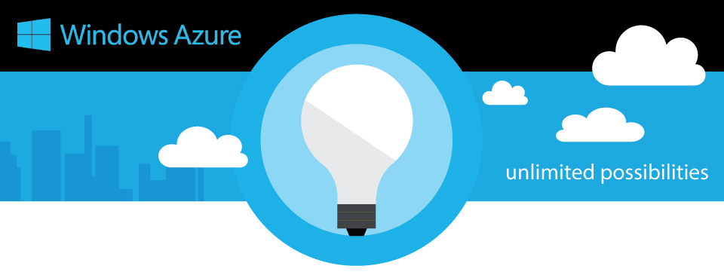
THANK YOU
@mohit_techy

